Slide 1


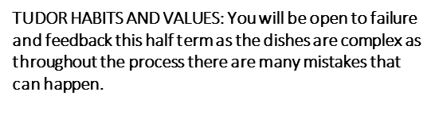
Learning Journey
Food & Nutrition
Vocabulary:
Staple food
Endosperm
Gluten
Chorleywood method
Knocking back
Topic Cereals
CEREALS
Practical 1
Cinnamon Swirls
Types of cereals
Types of wheat flour
Practical 2
Spinach & ricotta ravioli
Protein content in different flours
Functions of ingredients in bread making
Year 10 Spring Term 1
Practical 3
Bakewell Tart
A wide variety of cereals will be covered this half term including wheat, barley, oats, corn, rye and rice. Students will learn the multiple uses of cereals and grains and how it can be processed to make other food products. The practical skills you will be developing this half term will be preparing and enriching bread, making shortcrust pastry, making, shaping and filling pasta and preparing a dish using rice.
Stages of bread making
Practical 4
Risotto
Pasta
How is it made?
Types of pasta/rice

